Slide 1
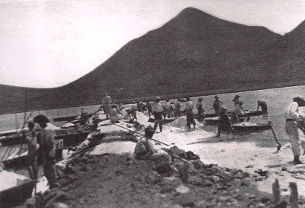
Migratory Bird Festival
The Great Salt Pond
A History of Salt on St. Martin
Dr. Jay B. Haviser, SIMARC
University of St. Martin, 17 Oct 2015

Slide 2
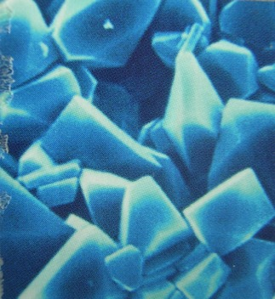
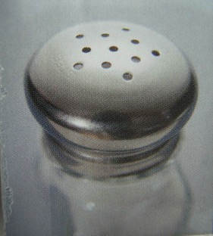
The Substance of Salt
Salt as a chemical is called…Sodium Chloride, …An adult body contains about 250 grams of Salt, but we loose it through sweat and urine, …and since we cannot produce sodium in our bodies, we have to replace it by eating salt.

Slide 3
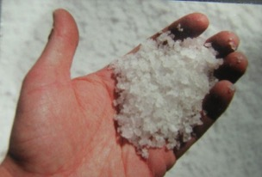
Salt is essential for human life
Salt is as important to humans
as food and water…yet is the
only rock that humans eat…
Our bodies need salt, as a kind of electrical charger for the brain…and to help with food digestion
Until about 100 years ago, Salt was one of the most important trade items in the entire world…the equivalent of Oil today!

Slide 4
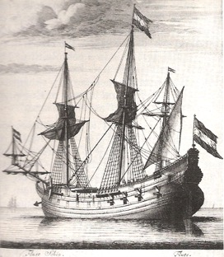

Salt for food preservation
One of the most important historical uses of salt is for the preservation of food…
Before there was refrigeration, salt could preserve food for weeks or months…
…for long sailing trips and journeys, where food was not available.

Slide 5
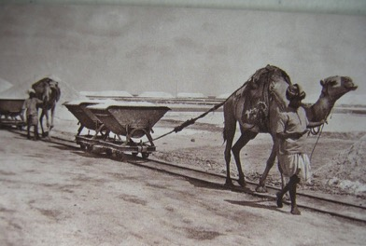
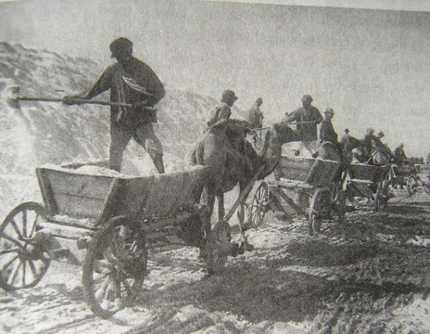
Salt used as money for trading
Salt was so important, it was used as money in trading…all around the world...and is still traded today.
Modern manufacture of salt
and automatic refrigeration,
have made it much cheaper
today

Slide 6
Famous sayings from Salt
The Latin word for salt was “sal”, and the word for payment “salary” comes from the fact that they used to pay people with salt…so a person would “earn their salt”, or be “worth their salt”…
The word “salad” comes from when the Romans would put salt on vegetables…

Slide 7
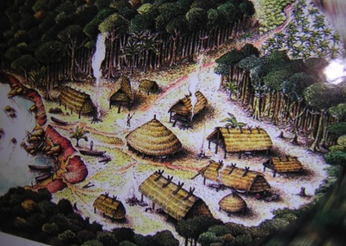
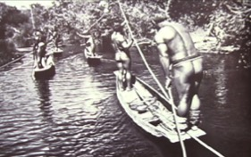

First use of Salt Pans
There is archaeological evidence that the indigenous Amerindians dried seawater
for salt…in natural ponds and lagoons…
…The Great Salt Pond
suited this use perfectly

Slide 8

St. Martin is named from Salt
The oldest recorded named for the island of St. Martin, was given by the Amerindian people,
and it was “Oualichi”,
…then after the arrival of the
Europeans, the Carib-speaking
Kalinago began to call the island
“Soualiga”,
…which meant the “Land of Salt”.
Amerindian descendent

Slide 9

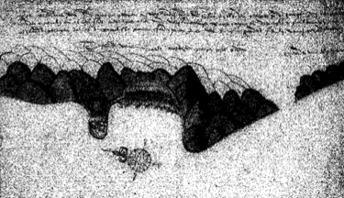
Europeans needed St. Martin Salt
When the first Dutch came to St. Martin, in 1627, they were foremost interested in the Salt here…
…because they needed
the salt to preserve their
herring fish for long journeys,
…as Holland does not
have natural salt mines,
and is too cloudy for
drying seawater.
1630s
Dutch map
with piers
at Great Bay
for salt ships

Slide 10
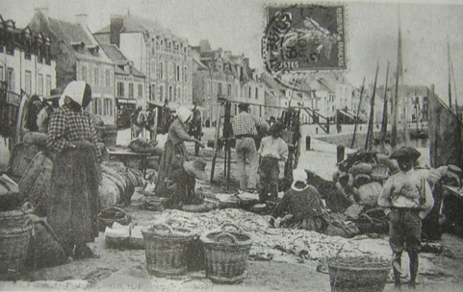
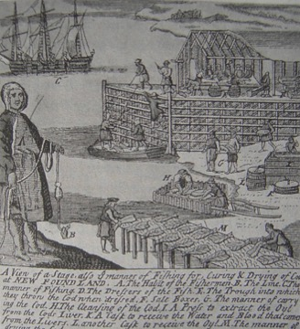
Salted fish was the main food for colonies
During colonial times, salted fish, were put in barrels and shipped to the colonies…
…but supplies were infrequent,
so local fishing and food crops were required,
…yet salt was still needed for preservation

Slide 11
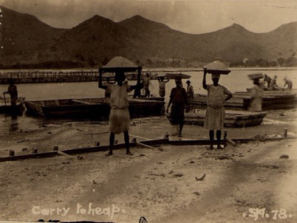
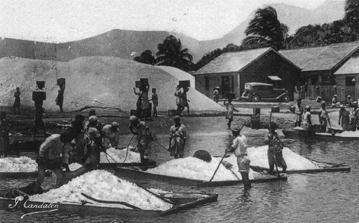
Salt work on St. Martin was exclusively by the Africans
When the salt was to be reaped from the ponds, it was the enslaved Africans on St. Martin who did the work…about 1000 workers over the years…
… this was brutal work, which burned their eyes, cut their feet and hands, then pickled the cuts…

Slide 12
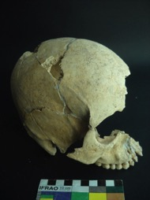
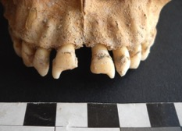
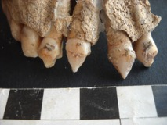
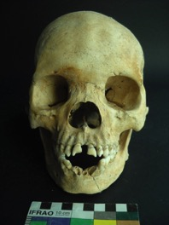
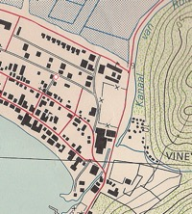
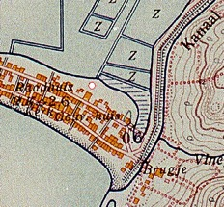

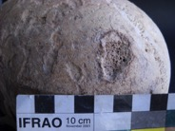
17th century African salt workers
Recovered at Zoutsteeg in 2010, three skeletons reveal
unique cultural practices among the early enslaved African
salt workers…
…DNA research is identifying origins
and relationships of the ‘Zoutsteeg Three’
Disease evident
20th c. cases
Ota Benga

Slide 13
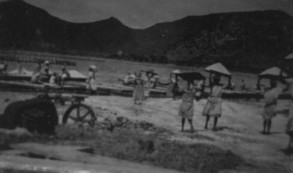
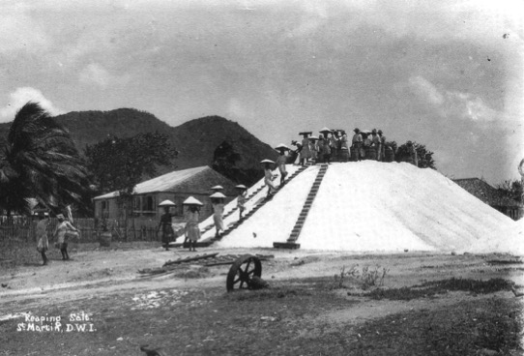
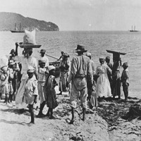
Salt work continued on St. Martin
After emancipation of the enslaved Africans, Salt work remained one of the major jobs on the island…for African descendents
Salt work continued until 1949 on the Dutch side

Slide 14


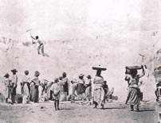
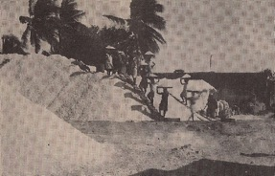
Passion and Rhythm of Salt Work
“Mark,
Mark,
Mark,
Mr. X “
Chants
and songs
of Salt work
An intimacy with the saltpans, naked and raw,
working and bonding in the toil of salt work…
…men , women and children, side-by-side.

Slide 15
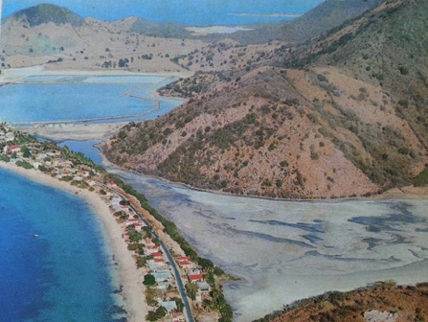
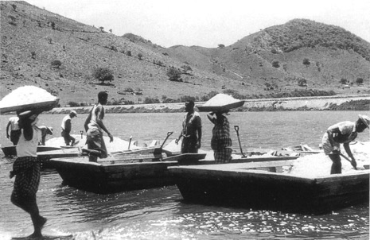
Salt Work on the French Side
The three saltpans were at Grand Case, Orient Bay and a smaller one at Bretagne…for awhile the French saltpans were operated by the Dutch side company…Salt work continued at Grand Case, until the early1960s…

Slide 16
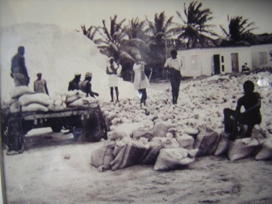
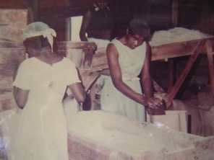

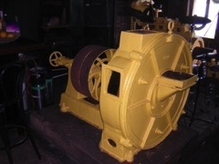
Salt Work on Anguilla
Salt work continued until 1967 on Anguilla…
In the 1950-60s, most of the
last salt workers on the French
side were from Anguilla…
Salt was refined in a crusher for export

Slide 17
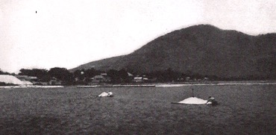
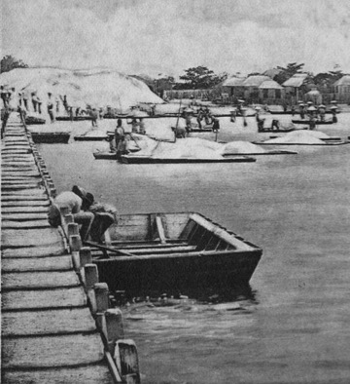
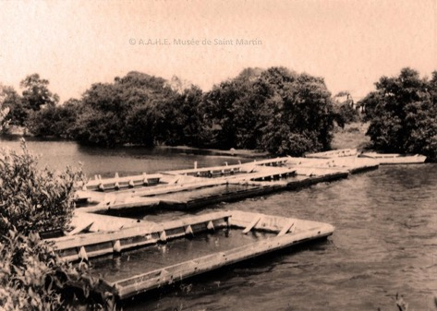
Salt Flats were used in the shallow waters
Flat-bottom wooden boats were built specifically for salt work in the pans…
Pushing
the flats
at GSP
Great Salt Pond
Grand Case

Slide 18
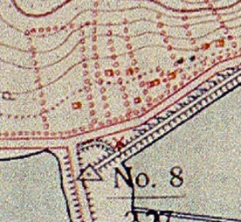
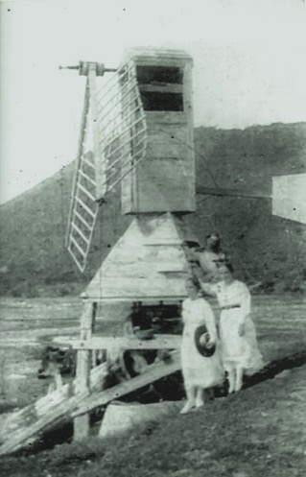
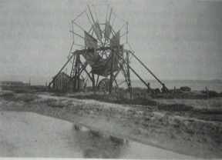
Wind Pumps used at the Salt Pans
Wind pumps were often used at Salt Pans to regulate the water levels in the pans.
Great Salt Pond,
Wind pump
still indicated on
a 1916 map
Perhaps a
restoration
project?
Turks and Caicos Islands

Slide 19
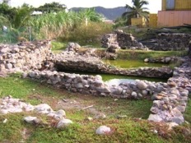
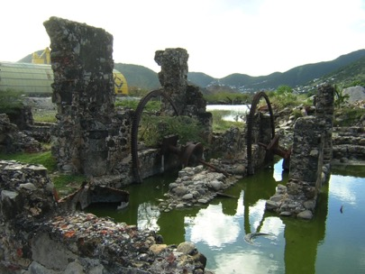
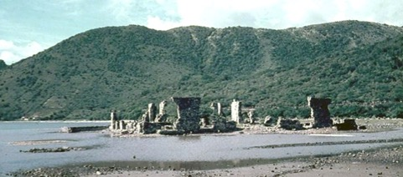
Salt work ruins at Foga
On St. Martin, we have the ruins of an 1862 steam-powered pumping station, used to help dry the salt pans… at Foga near Madame Estate.
1960s
…once a majestic historical monument,
now it has been severed from the Salt Pond it used to serve…

Slide 20
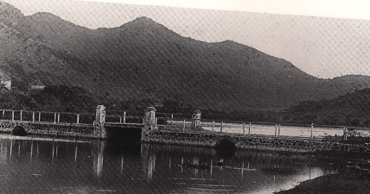
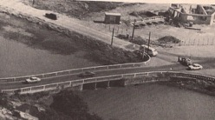
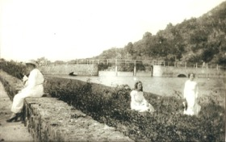
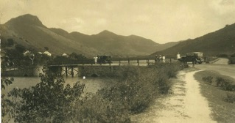
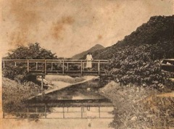
Associated historical features
Historical features associated with the Great Salt Pond, are the oldest bridge on St. Martin at Long-Wall Road and the Rolandus Canal
Long-Wall Bridge /Road (ca. 1930) ,
An important gather place, later named
Prince Bernhard Bridge (1950)
Rolandus Canal built
in the 1852, for water
run-off from the salt pans

Slide 21
Some interesting legal events for the Great Salt Pond
1749 Forbidden to walk on the Great Salt Pans
1749 Specific opening times to access the Great Salt Pans
1762 Spoiling of seawater for the pans due to clothes washing
1767 Forbidden to fish in the Great Salt Pans
1740s-1770s Various govt repairs to the saltpans / northern dike
1792 Long Wall built to separate fresh from salt water
1648-1830 Public use of the salt pans, albeit under sellers control
1831 First private ownership of saltpans granted, A. Perrinon
[1848-50 Peak years of salt production at 337,000-400,000 barrels]
Rolandus Canal built/Long Wall expanded for water drainage
One Dutch company operates both sides saltpans
1862 Foga steam works built to pump out fresh water
Property rights bought by L. van Romondt
1939 End of the Perrinon long-lease, new leases granted
Salt production was stopped on the Dutch-side
2009 The Great Salt Pans are officially designated as a
Historical Monument by the Government of St. Maarten.

Slide 22
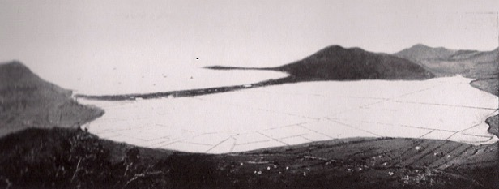
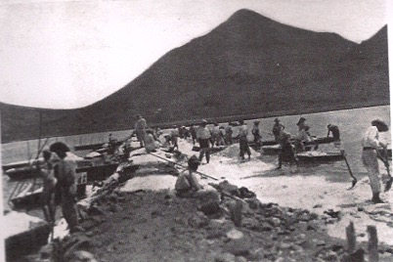
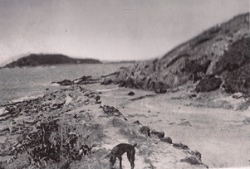
An important document from 1919
In 1919 NWIG published ‘Het Zoutbedrijf opSt. Martin’ by F. Langemeyer, with vital information about the Great Salt Pond and Salt Pans until that time…
Great Salt Pond
with saltpans,1919
Salt workers
Fresh Pond
Sea access
Canal
From 1850s

Slide 23
The Significance of 1831 for the
Great Salt Pond
Reglement op het beleid van de Regeering, Art. 57, 14 Sept 1815
“Gelijk van alle tijden de zoutpan op St. Martin is geconsidereerd
als het gemeen eigendom der ingezetenen, zoo wordt ook dat
eigendom aan hen bevestigd.”
In 1831, five private persons were granted rights/ lease of several
saltpans on both French and Dutch sides ..a great controversy and
Public outcry ensued …
Protest from the French Government, directly to Den Haag, left the
Caribbean colony authorities out of the discussion…legal battles until
1858…then by Royal Decision (No. 12, 21 Juni 1858), A.F. Perrinon
(a Frenchman) was granted a 80 years lease…including the rights to
open-passage of seawater for the small concessions.
His first company, ‘Maatschappij tot Zoutwinning op het eiland St. Martin’,
failed after 10 years. ‘Exploitatie Maatschappij van Zoutmeren’ was est.
in 1868, under C. Hudig.

Slide 24
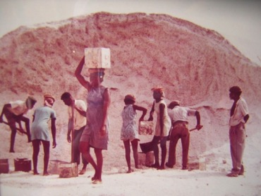
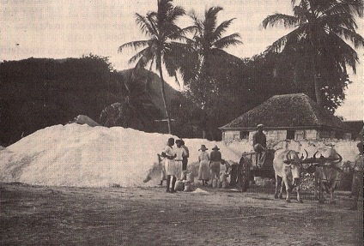
Decline of the Salt Industry
Hurricanes and the US Civil War
affected salt production/sales on
St. Martin in the late 19th century…
…by 1949 it was finished on the
Dutch side…
Anguilla 1960s
..Saltwork lingered until early 1960s
on French side and 1967 on Anguilla..
Many salt workers moved to the
Oil refineries at Curacao and Aruba in the 1920s.
Great Salt Pond 1923

Slide 25


Great Salt Pond through historical maps
Here on St. Martin, the Great Salt Pond had large Salt Pans…for centuries…
17th century
maps of
St. Martin
salt pans
on both
Oldest known map of St. Martin, 1620s
Spanish map of St. Martin ,1630s

Slide 26



18th century maps
Proposed saltpan divisions
planned in the 1780s,
for the Great Salt Pond
1775
First indication of
the Long-Wall Bridge

Slide 27







19th century maps and drawings
Blanken
1819
Fahlberg
1817
1822
Slotemaker 1864

Slide 28





Early 20th century maps and photos
ca.1900
ca.1930
Werbata 1916
1919
Note the ‘large’ and ‘small’
concession salt piles in Philipsburg

Slide 29



Mid 20th Century photos
1920-30s(?)
Early 1960s
Late 1960s

Slide 30



Late 20th century photos
1969
1970

Slide 31





Early 21st century photos
begin
Ring
Road

Slide 32







Ring Road and fill construction 2010
Damage to the Salt Pans
and bird sanctuary
The Salt Pans must coexist with our
University, Festival Center, Govt Bldg
Reduced water capacity
…and the dump
just keeps on growing

Slide 33


Where to go from here?
Protection and education together,
if we can create a Salt Walk Park
at the Eastern Salt Pans…
…and every 10 meters along the
Walk the name of a St. Martin man
or woman who worked the pans…
…a sanctuary for birds and an
Educational center for our youth.

Slide 34






…and still the Salt Pans survive…

Slide 35




…even as the dump continues to burn...
…even as the bulldozers continue
to pile sand atop our heritage…and drought dries them to a bone…
…the ‘Spirit of the Salt’ lives on

Slide 36







St. Martin ‘Spirit of the Salt’ is where the umbilical meets the earth, merging rock with flesh

Slide 37

Next time you eat, think about Salt, and remember the heritage that our Great Salt Pond stands for!
Salt is the rock
of our body need,
Salt is the spirit
at the very seed,
of St. Martin heritage…
…We must preserve
St. Martin’s Spirit
with our Great Salt Pond!

Slide 38

Credits and Thanks
My sincere thanks go to…
Ms. Elsje Bosch (St. Maarten Museum),
Mr. Christophe Henocq (St. Martin)
Mr. Will Johnson (Saba)
Mr. Rob Vershueren (St. Maarten)
Mr. Ellinger Paul (St. Maarten)
…for use of some of their historical photographs.

